Slide 1
Utah Transit Authority
Rideshare
Vanpool
Pass Products

Slide 2
UTA Rideshare
Rideshare Mission
To educate the community concerning alternative transportation options and promote those options that reduce single occupancy vehicle usage, improve mobility, enhance air quality, and conserve energy.
The Rideshare Department supports the operations of the following services :
- Carpool - Community Education
- Vanpool - Alternative Work Hours
- Bicycling - Telecommuting
- First and Last Mile Solutions - Surveys
- Commuter Matching Services
Vanpool is most successful and measurable Ridesharing program with over 400 vanpools operating each year and carrying over 14 million passengers a year.
Notes:
UTA Rideshare has a staff of 9 people who help manage the day to day operation. We work in concert with our marketing representatives promoting transportation alternatives.

Slide 3

2016 Statistics
Passenger miles traveled – 49 Million
Vehicles taken off the road – 1.3 Million
GHG reduction 35.2 Million pounds
Source: http://media.treehugger.com/assets/images/2017/01/blue-whale-size.jpg.662x0_q70_crop-scale.jpg
Notes:
To put this in perspective, Mars is 49 million miles from Earth. Last year vanpool participants traveled to Mars.
As with other transit modes, passenger participation is counted as one-way trip segments. Imagine the contribution to congestion if each one of these trips was taken in a single occupancy vehicle (SOV).
The amount of foreign matter that didn’t get put into the air we breathe last year would weigh as much as this little guy and 16 of his friends.

Slide 4
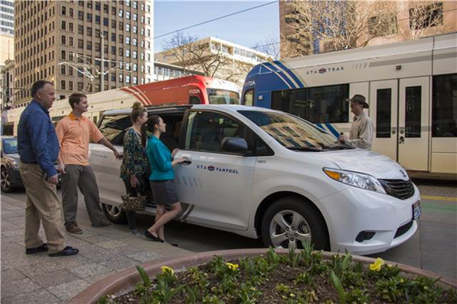
Types of Vanpools
Traditional
Shuttle
RideVan Plus
Notes:
Typically traditional vanpools meet at a specified location and may make a stop or two along the way to the same destination each day.
Shuttles are sponsored by employers who want to transport employees from one location to another. These may make multiple trips during the day.
RideVan Plus is a first/last mile solution that incorporates a pass to use on buses and trains with the vanpool fare. The van is usually parked near a bus stop or train station and takes the group the last leg of the trip on the van. The reverse is also possible if the group wanted to take a van from a neighborhood to a transit stop.

Slide 5
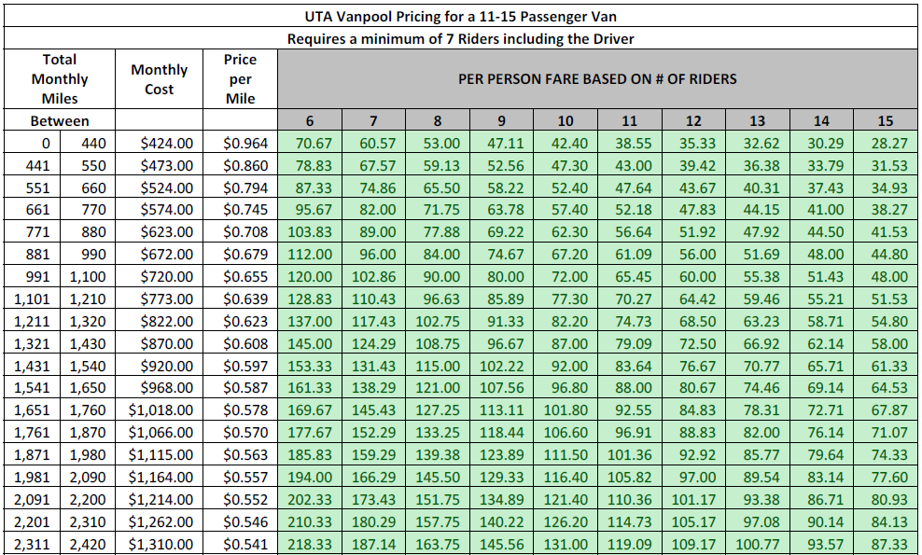
Cost of Participation
Traditional Vanpool and Shuttle mileage based
Notes:
This is an example of the individual cost for vanpools or the monthly cost for a shuttle sponsored by an employer based on the current pricing model.

Slide 6
RideVan Plus
Monthly Fare per Person Based on Number of Riders
Number of Riders | 6 | 7 | 8 | 9 | 10 | 11 | 12 | 13 | 14 | 15
Premium Eco Pass Holder Rate | $43 | $37 | $33 | $29 | $26 | $24 | $22 | $20 | $19 | $17
Standard Rate | $93 | $87 | $83 | $79 | $76 | $74 | $72 | $70 | $69 | $67
Cost Sharing Option
  Employers who want to share costs with employees can pay $260 per month for the use of the van. Employees then pay $50 per month. Total employees is based on the available seats in the van.
Notes:
By including the fare for transit and vanpool, RideVan Plus provides a significant discount to employers and individual participants. Currently 23 RideVan Plus vans are in operation.

Slide 7
What’s Included
Maintenance
  Preventative and Repairs
  Loaner vans
Insurance
Fuel
Guaranteed Ride Home
Notes:
UTA contracts with a number of service providers to maintain and repair the vans. UTA is billed directly by the authorized service provider when a van is taken for scheduled maintenance or repairs. Most shops have loaner vans available if the driver doesn’t have time to wait for the service to be performed. It’s best to call ahead to make sure one is available.
Included in the vanpool cost is insurance for vanpool groups and approved drivers.
Each van comes with a fuel card, costs of which are also included in the vanpool fares.
UTA provides a safety net for participants who have unexpected situations arise due to unscheduled overtime, illness, or an emergency for example.

Slide 8
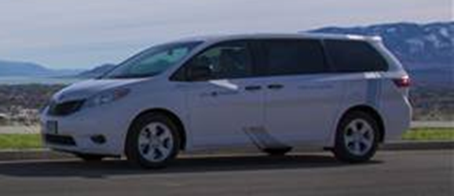
Fleet Options
Full size vans - 11, 12, and 15 passenger capacity
Minivans – 7 passenger capacity
Notes:
We have two van size options available. One of the challenges with vanpool participants who receive an employer subsidy is the amount they receive is based on the number of seats in the van. Any empty seat costs are shared among the participants, who may have to pay a portion out-of-pocket. One of the ways we are trying to help resolve this issue is by introducing a few mid-range capacity vans into the fleet to accommodate groups who have too many for a minivan and not enough to fill a full size van.

Slide 9
How You Contribute
Have the van serviced
  According to the schedule at an authorized provider
Track ridership
  Report the number of participants and mileage monthly
Keep in touch
  Notify us of changes to routes and participation
Notes:
Vans come with a preventive maintenance schedule, specific to the make and model of the vehicle. Vans that are well maintained will last longer and experience fewer mechanical failures.
UTA reports vanpool ridership through the National Transit Database to the Federal Transit Administration. Funds from the FTA are awarded to projects such as The Congestion Mitigation and Air Quality Improvement Program (CMAQ), of which UTA is a participant.

Slide 10
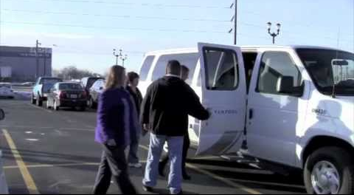
Getting Started

Slide 11

Employer Sponsorship
Employer contract
Payroll deduction
Third-party benefit provider
Preferred parking
Notes:
The cost of a van can be subsidized wholly or in part by the employer. If an employer chooses to sponsor a vanpool the levels of involvement can be tailored to the particular situation. If an employer signs a contract with UTA, the duration can be from two months to several years. The responsibility for ridership reporting in this case usually lies with a company representative. A company representative will also make sure the maintenance activities are completed by an authorized van driver. If a partial subsidy works better, the employer can chose to cover part of the payment and the employees can cover the rest through payroll deduction. Some employers chose to provide the funds for the vanpool but the responsibility for the day-to-day operation remains with the group. In this case the employer doesn’t sign a contract.
Many Flexible Spending Account (FSA) providers also offer fare media for commuter benefits. Unlike other components of these plans no long term commitment is required to participate in the commuter option.
A low cost option employers can provide is to offer preferred parking for employees who choose to vanpool or carpool.

Slide 12
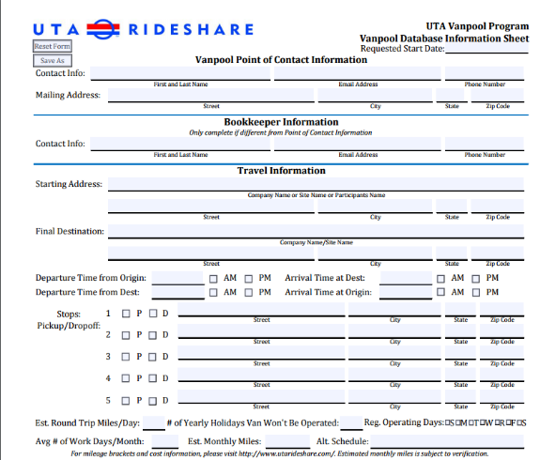
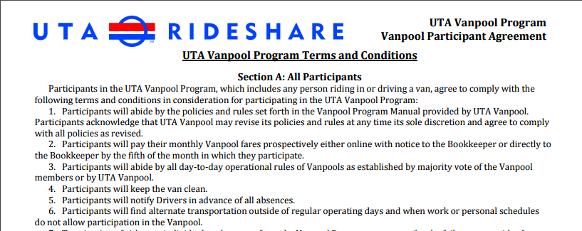
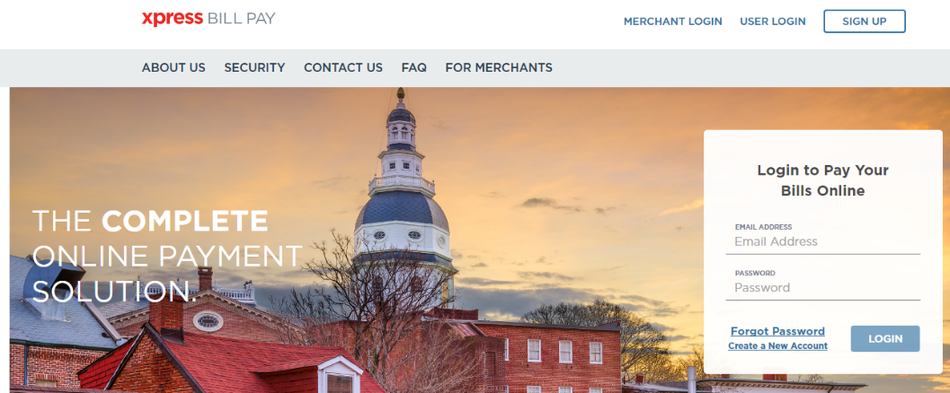
Individuals
Forms
Billing
Responsibilities
Notes:
Establishing a new vanpool is fairly simple. We collect routing information, participant agreements, which outline the terms and conditions of being part of a vanpool, and driver applications. Drivers are required to go through training and we review their driver history to ensure they meet our driver selection standards.
Participants should provide advance notice of moving to a different vanpool or discontinuing participation to maintain billing accuracy and fare distribution. We go through an online billing provider to collect payments, each person will receive an account number and access to the payment system once a vanpool has been established. Payments are due on the 5th of every month for that month’s participation.

Slide 13


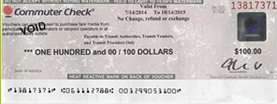
Paying for Vanpool
Online payment provider
Fare media
Pre-tax options
  FSA
  Employer benefit
Notes:
Vanpool payments are submitted online through Xpress Bill Pay. Credit and debit cards are accepted as well as EFTs. Company sponsored vanpools typically receive an invoice but can also pay through Xpress Bill Pay.

Slide 14
Additional Resources
IRS Employer's Guide to Fringe Benefits
UTA Vanpool

Slide 15
Introduction
Product Development & Sales Team
  Develop and market pass products
Marketing Representatives
  Manage contracts, create and build community relationships, & support ridership initiatives

Slide 16





Pass Programs
  Bulk pass purchases available
    Corporations & Non-profits
    Educational Institutions
    Developers, Property Owners, TOD Partners
  Guided by UTA fare policy
  Electronic fare media

Slide 17
Pass Products
  Annual Preferred
  Annual Select
  Monthly
  Daily
  UTA FAREPAY Card

Slide 18
Annual Preferred
  Requires 100% Participation
  Sponsoring entity has to employ a minimum of 30 individuals
  Valid on all UTA modes
  One year agreement
  Payment due in full upfront

Slide 19
Annual Select
  15 minimum employee participation
  Able to add additional passes on a pro-rated basis throughout the year
  Valid on all UTA Modes
  One year agreement
  Payment due in full upfront

Slide 20
Monthly
  15 minimum employee participation
  Able to activate and deactivate passes on a monthly basis
  Valid on all UTA Modes
  One year agreement
  Invoiced monthly based on the number active passes

Slide 21
Daily
  Daily rate for unlimited travel
  Daily taps are totaled up at the end of the month and then invoiced
  Valid on all UTA Modes
  One year agreement

Slide 22
UTA FAREPAY Card
  Reloadable electronic fare card
  Card holders receive a 40% promotional discount on local bus fares & 20% on all UTA Rail trips
  Cost: $3.00/card
  Can load anywhere from $5 - $500
  Online account protects from theft & loss

Slide 23
Benefits
Guaranteed Ride Home Program
Reduces SOV (Single Occupancy Vehicle) trips that impact traffic & parking
Environmental steward
Recruiting tool for HR
Cost-savings for your employees

Slide 24
Contact Information
UTA Rideshare & Vanpool
http://www.rideuta.com/Rider-Info/Vanpool
utarideshare@rideuta.com
801-743-3826
UTA Pass Programs
passprograms@rideuta.com
801-237-1931

Slide 25
Questions?

